Slide 1
GA Method Solving Travel Salesman Problem
Team member:
Ruofan Zhang 001470033
Xinyang Wu 001445433

Slide 2
Problem Description
Suppose there is a traveler who wants to visit a city, ask him to start from a city, visit each city at most once, and finally return to the starting city to ensure that the selected path length is the shortest.
Our goal is to use GA to find an optimal solution to this problem.

Slide 3
GA Implementation Description
Part 1. Class Description
To solve TSP problem, We implement Chromosome class, City class, Population class. These are Genetic Objects. We also implement Mutation class ,Crossover class, Selection class. And we use GeneticAlgorithm class to bring together the entire process of the Genetic Algorithm.

Slide 4
Part 2. Details of Class
For GeneticObjects Package
1.City class
It has methods to create cities with random names and random locations and find the Euclidean distance between two cities.
2.Chromosome class
It contains an array of City objects which represents a path through the cities. You can choose shuffle them or not.
3.Population class
It represents a Population of chromosomes.

Slide 5
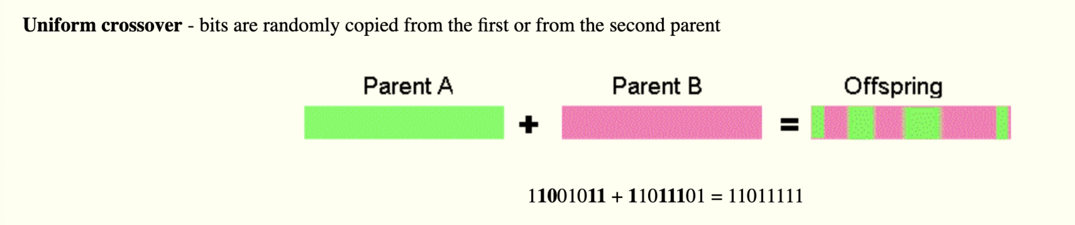
For GeneticAlgorithms Package
1. Crossover Class
It used for Chromosome reproduction. We create three methods to realize the crossover and implement the best of them(uniform order).
1) Uniform Order
We use a bit mask to perform a uniform order crossover.

Slide 6
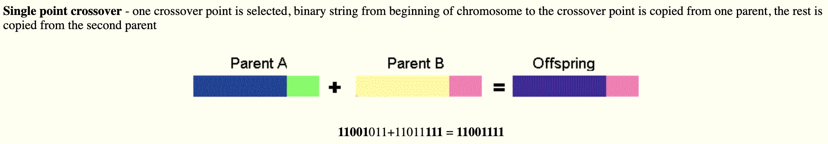
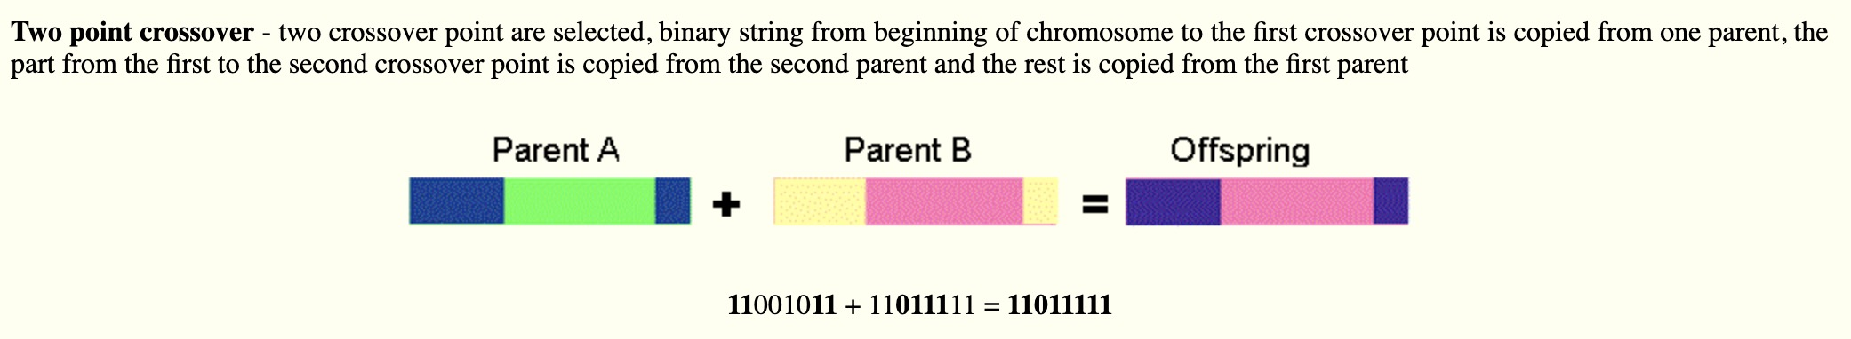
2) One Point Crossover
It performs a crossover on all the cities after a particular point.
3) Order Crossover (Two Point Crossover)
It performs a crossover on all the cities between two points.

Slide 7
2. Mutation Class
It used for mutating the Chromosomes. We also created three different methods to realize the mutation and implemented one of them.
1) Insertion
It selects a city and inserts it into a random place.
This is a very effective mutation and is almost the same as Displacement Mutation, except here only one gene (i.e.; 2) is selected to be displaced and inserted back into the chromosome. In tests, this mutation operator has been shown to be consistently better than any of the alternatives mentioned here.
0 1 2 3 4 5 6 7
Take the 2 out of the sequence,
0 1 3 4 5 6 7
and reinsert the 2 at a randomly chosen position:
0 1 3 4 5 2 6 7

Slide 8
2) Reciprocal Exchange
It swaps two randomly selected cities.
Suppose we have a chromosome:
5 3 2 1 7 4 0 6
We simply choose two genes at random (i.e.; 3 and 4) and swap them:
5 4 2 1 7 3 0 6
3) Scramble Mutation
It picks a subset of Cities and randomly re-arrange them.
Choose two random points (i.e.; positions 4 and 7) and “scramble” the genes located between them:
0 1 2 3 4 5 6 7
becomes:
0 1 2 5 6 3 4 7

Slide 9
3. Selection Class
It determines which chromosomes will survive and potentially reproduce.
We implement tournament selection in this part.
1)Select k random Individuals from the population.
2)Select the best Individual from the k Individuals.
3)Repeat from 1 until you have selected the desired amount of Individuals.

Slide 10
Result
No.1
Preset
1. We set the size of the population to 500, number of generations to run to 500, odds that crossover will occur to 0.90 and odds that mutation will occur to 0.04 in our Preset class.
2. We use the UNIFORM_ORDER method for crossover and INSERTION method for mutation.

Slide 11
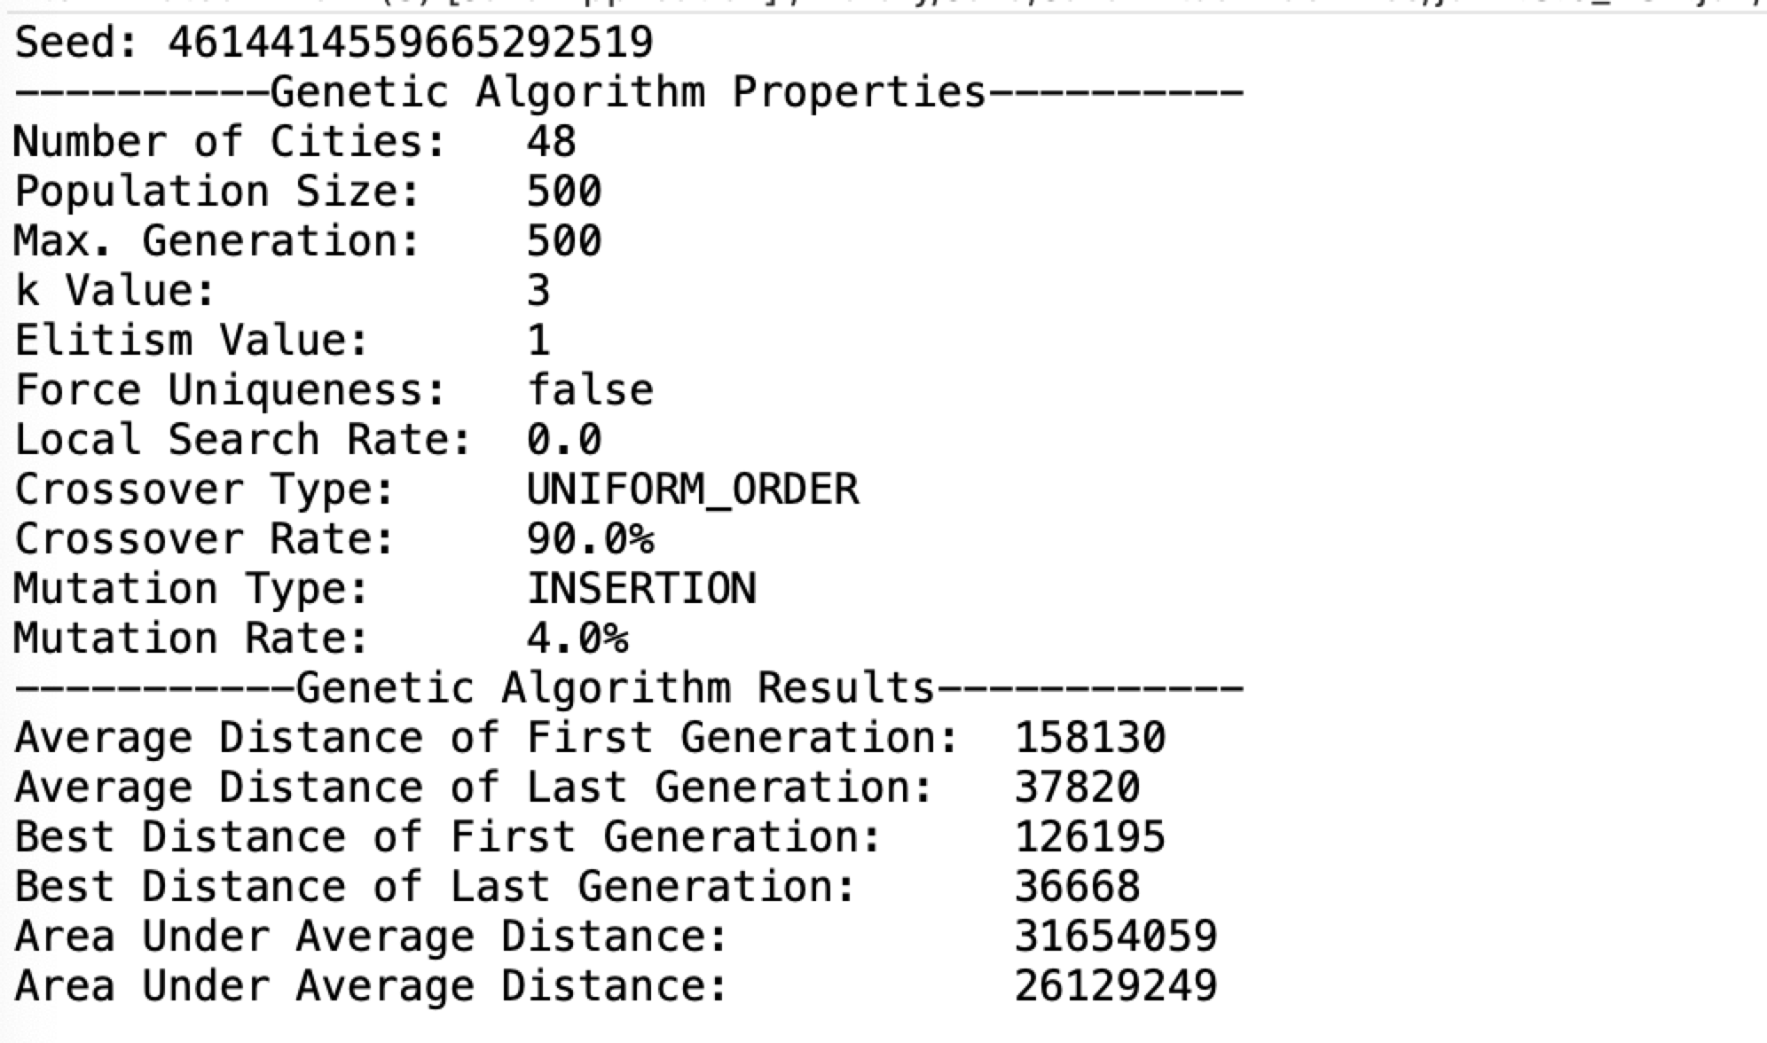
Run
1. We run the Main class.

Slide 12
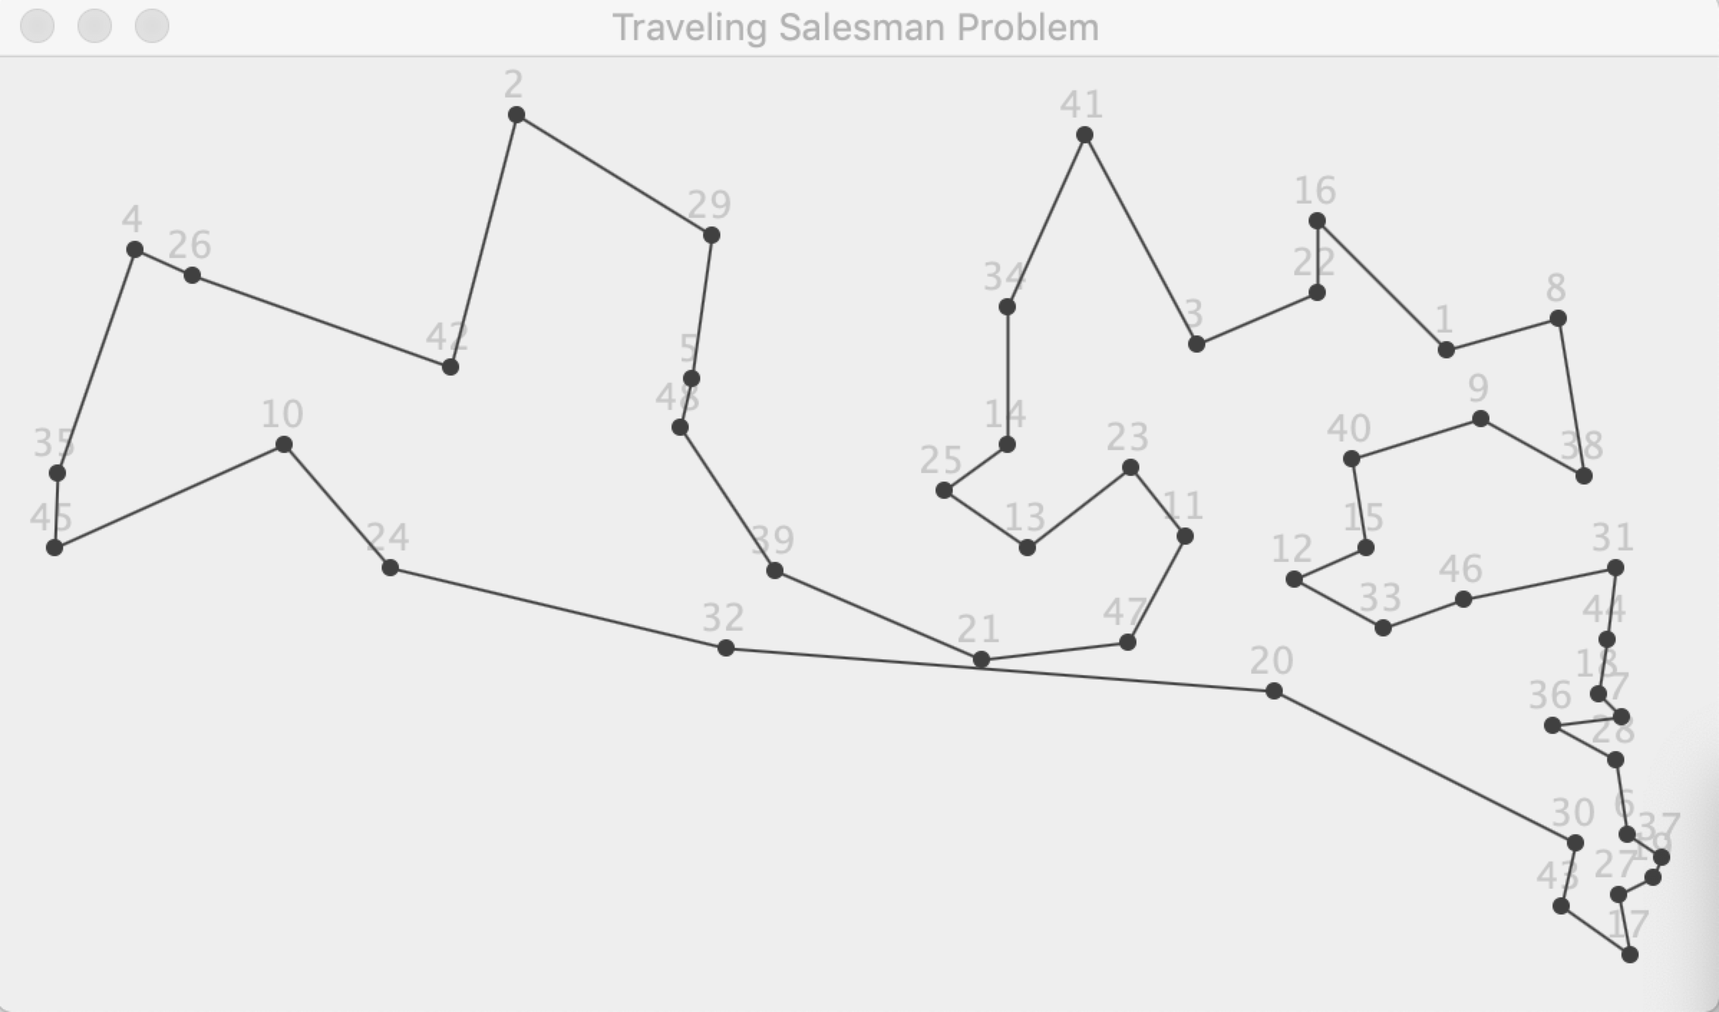

Slide 13
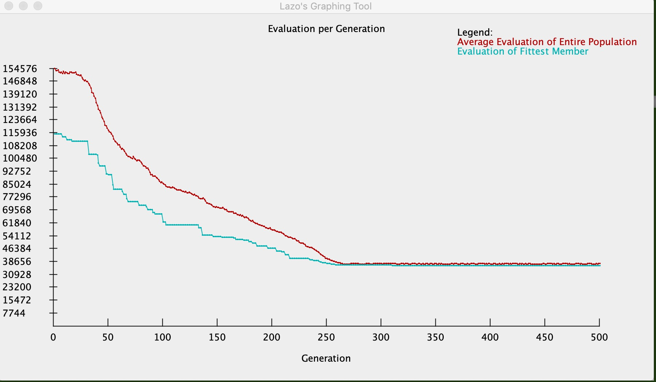

Slide 14
No.2
Preset
1. We set the size of the population to 500, number of generations to run to 500, odds that crossover will occur to 0.90 and odds that mutation will occur to 0.04 in our Preset class. (no change with no.1)
2. We use the ONE_POINT method for crossover and RECIPROCAL_EXCHANGE method for mutation.(change the methods)
Run
1. We run the Main class.

Slide 15
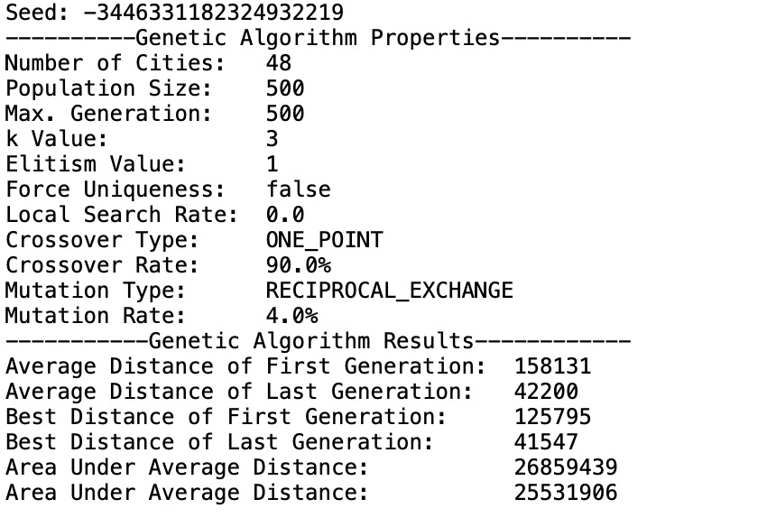
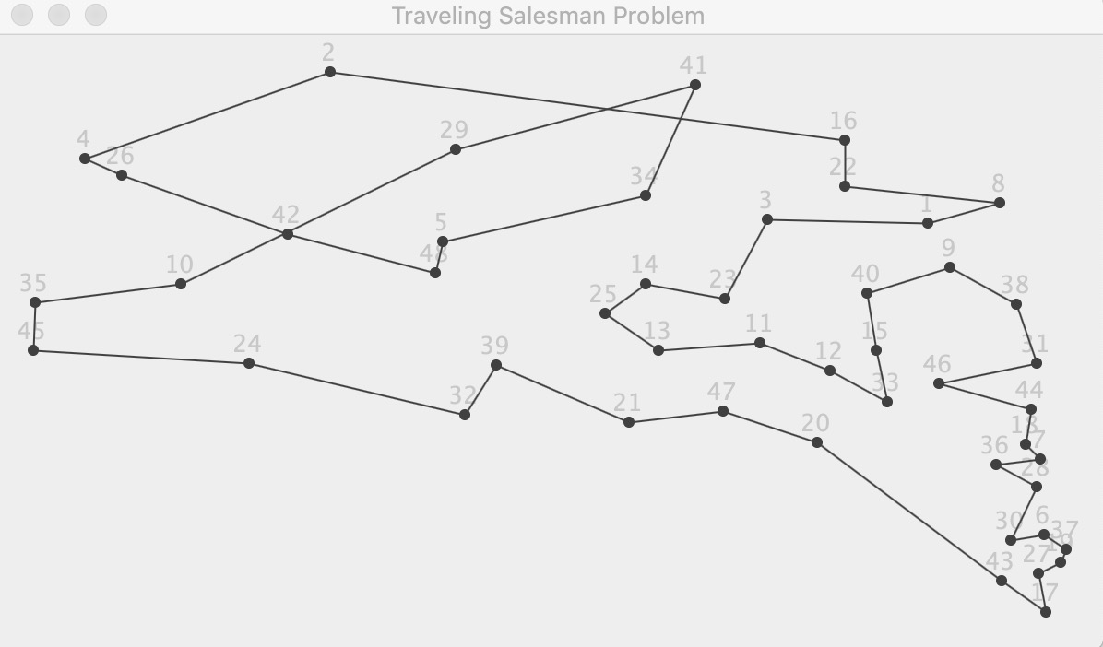

Slide 16
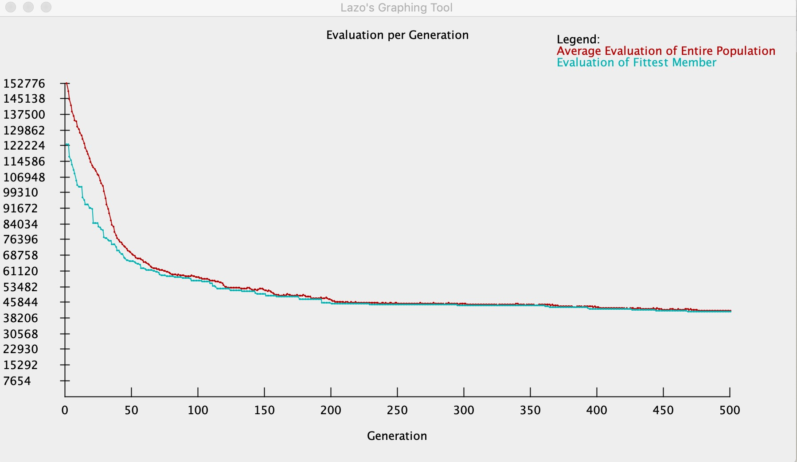

Slide 17
No.3
Preset
1. We set the size of the population to 500, number of generations to run to 1000, odds that crossover will occur to 0.90 and odds that mutation will occur to 0.04 in our Preset class. (change the preset data)
2. We use the ONE_POINT method for crossover and RECIPROCAL_EXCHANGE method for mutation.(no change with no.2)
Run
1. We run the Main class.

Slide 18
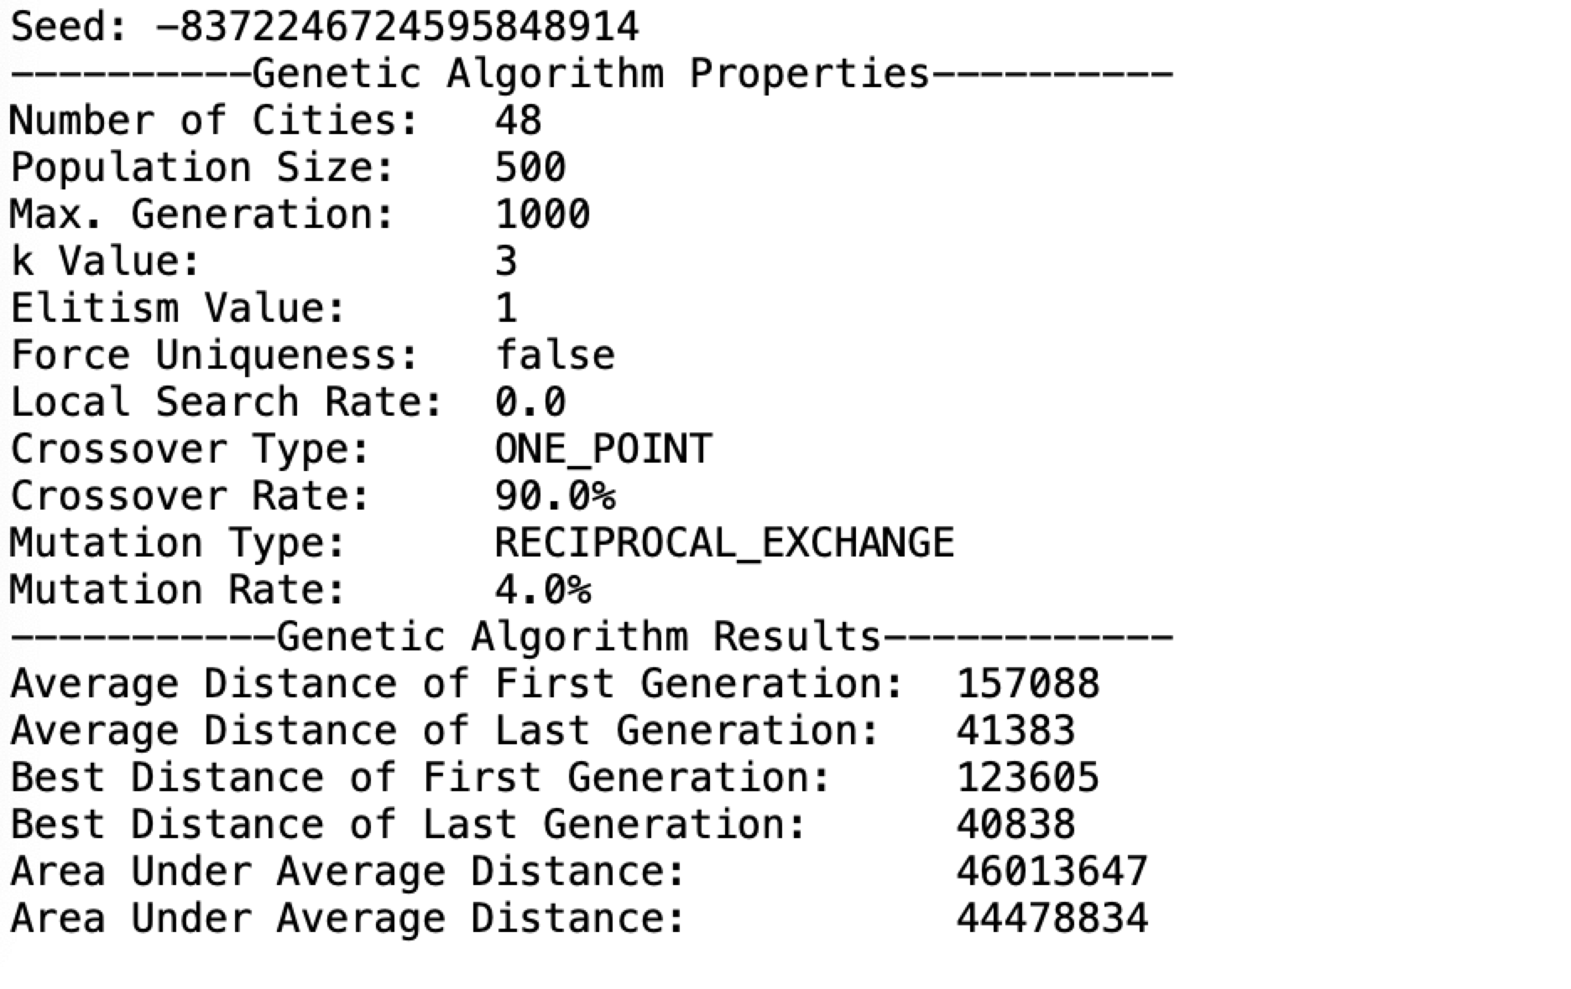
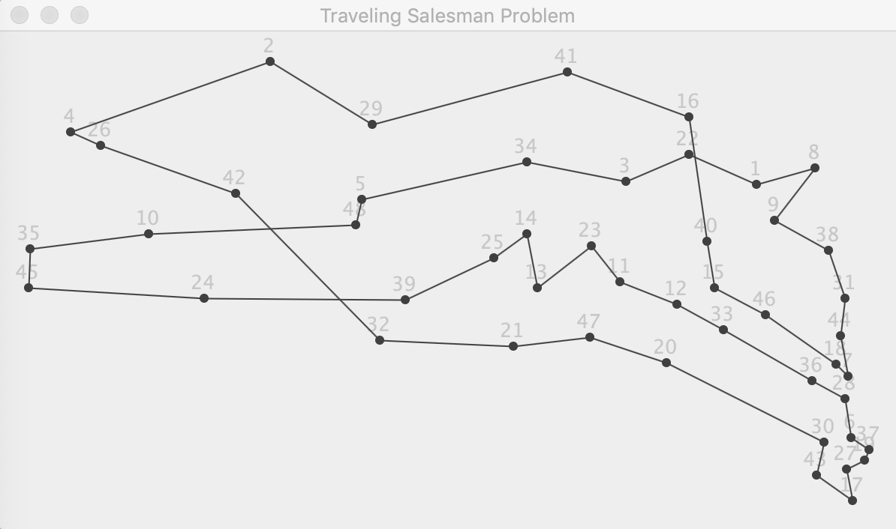

Slide 19
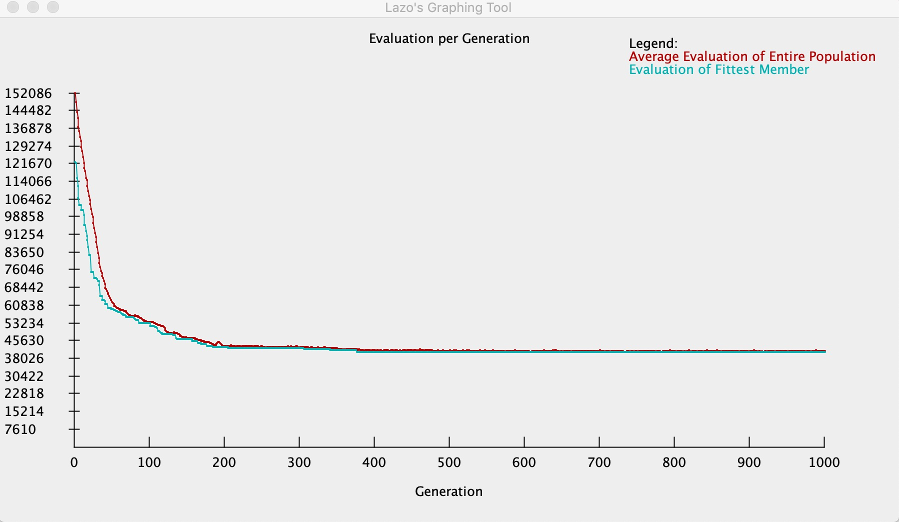

Slide 20
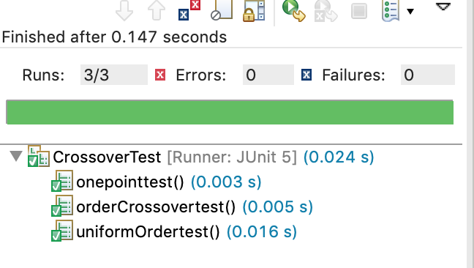
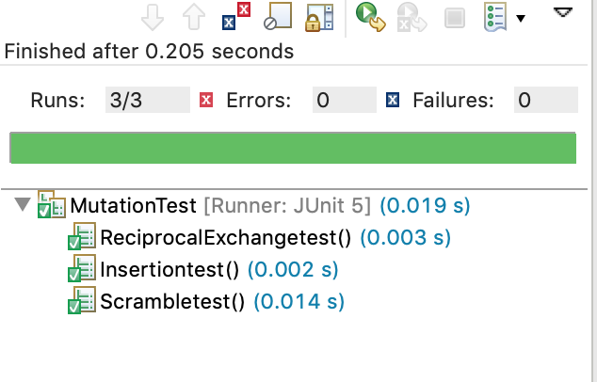
Test
Mutation test
Crossover test

Slide 21
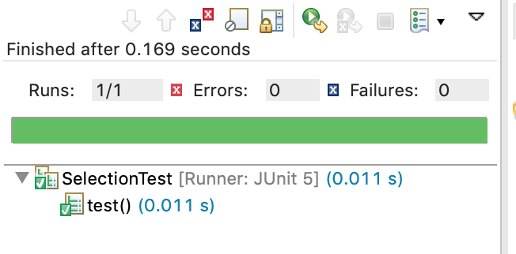
Test
Selection test

Slide 22
Conclusion
Genetic algorithms are evolutionary techniques for survival purposes based on the most appropriate ideas for survival. These methods do not guarantee the best solution; however, they usually give good approximations in a timely manner. Genetic algorithms are useful for NP-hard problems, especially for traveling salesmen. Genetic algorithms depend on selection criteria, crossover and mutation operators.
According to the specified number of iterations, when the algorithm reaches the number of iterations, the algorithm ends and outputs the current optimal solution. When calculating and selecting from the adaptive values, the current best value of the record is added to the updated group after ensuring that the TSP solution is getting better (no worse) in the new iteration loop.
We tried different methods, but in reality they have little effect on the results.
Through testing, we can get the best path no matter what method we use, although sometimes the results are almost optimal.

